Slide 1
Energy Efficiency Opportunities in Wastewater
Illinois Rural Water Association 29th Annual Technical Conference
February 2011

Slide 2
Presentation Outline
Why Efficiency is Important
Getting Started with a Baseline
Find where you are with a Benchmark
Common Efficiency Opportunities
Success Stories
Final Thoughts

Slide 3
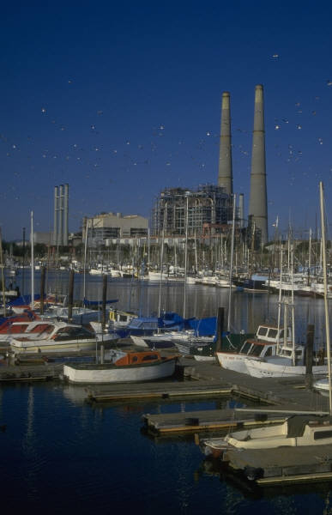
Economic Benefits of Efficiency
Reduces the need for new power plants
  New power plant cost
  greater than $3,000/kW
  Efficiency program cost
  less than $500/kW
Reduced environmental impacts, including costs

Slide 4
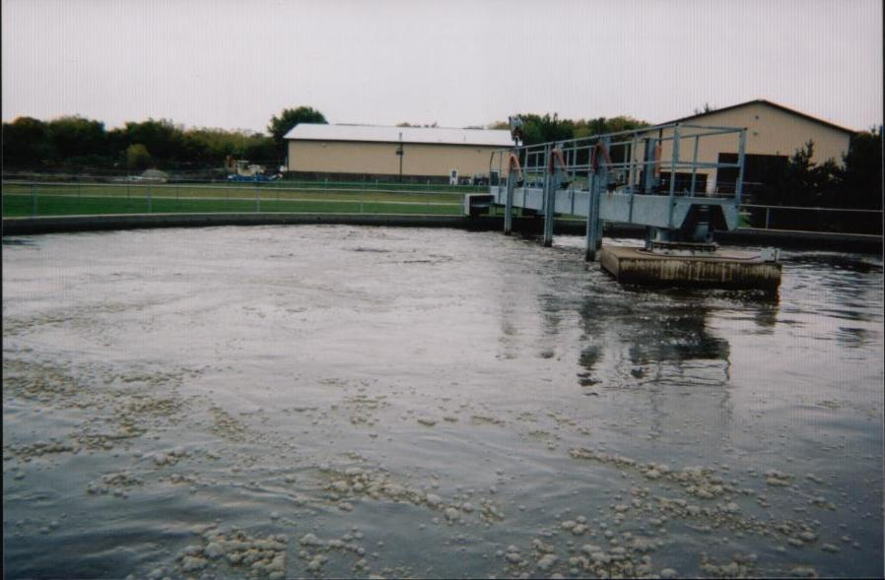
Energy Awareness
Facilities Consume 35% of municipalities’ energy use
Operation is 24/7
Non-interruptible services
W/WW energy costs are $9 billion/yr
W/WW consume 70 billion kWh/yr

Slide 5
Better payback on efficiency with continuous operation
  Single shift
    (8 hours per[/] day) (5 days/week) (52 weeks/year)
    = 2,080 hours/year
  Continuous
    (24 hours/day) (365 days/year) = 8,760 hours/year
    8,760 hours/year / 2,080 hours/year = 4.2 times longer

Slide 6
State of Wisconsin Wastewater Treatment Facility Sizes
Over 80% of facilities are under 1 MGD (very representative of most states)

Slide 7
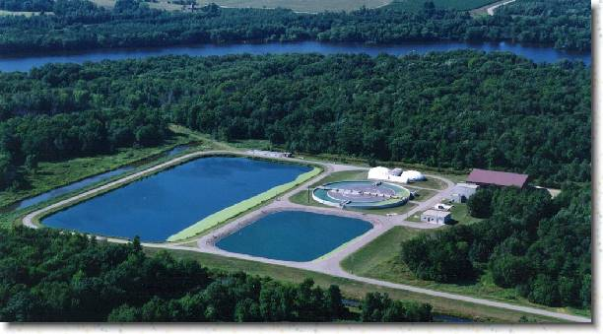
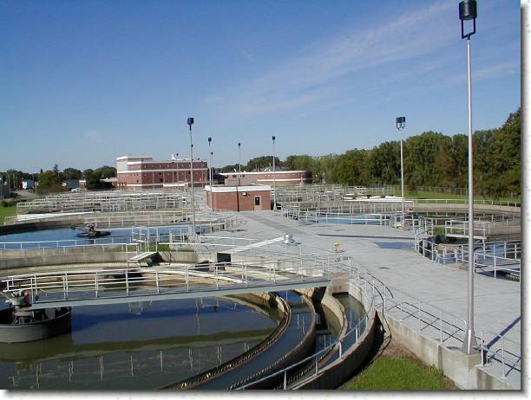
All Facilities Have Savings
Irrespective of age, all facilities have savings
All sizes have savings and percent of savings

Slide 8
All Facilities Have Savings
MGD = million gallons per day
Source: Focus on Energy," Water and Wastewater Energy Best Practice Guidebook”

Slide 9
Energy Baseline
Find out where you’re at (baseline)…
…so you can figure out where you want to go (benchmark).
You will want to be able to show where you started from.

Slide 10
EPA Guidebook
Ensuring a Sustainable Future:
An Energy Management Guidebook for Wastewater and Water Utilities
http://www.epa.gov/waterinfrastructure/bettermanagement_energy.html
A great tool to help you gather the data to baseline

Slide 11
Data to Gather
Energy bills
Demand and consumption
Size of treatment units
Design memorandum
Existing loading information
Effluent limits
Site input
Equipment data

Slide 12
Benchmarks to Watch
Plot energy consumption and demand vs. flow
Plot energy consumption and demand vs. BOD load
Variability of process equipment (sizing and what it does)
Variation in loading hourly/daily/weekly
Distribution of energy consumption among systems

Slide 13
Electricity Requirement for Typical Activated Sludge Facilities (Water Environment Federation)
Pumps and Aeration are usually the best opportunity

Slide 14

Water and Wastewater Energy Best Practice Guidebook
A good source for Benchmark metrics
A good source for common opportunities

Slide 15
Common Opportunities
Wastewater
Demand Management
Aeration
Pumping
Variable-speed drives
Automatic Controls
Solids management
Operation
Equipment selection
Water
Pressure
Throttled Valves
Drives
Controls
Pumps
Operation

Slide 16
Demand
Ask your account rep for 15-minute demand graph.
Plot Flow Vs. Demand

Slide 17
Understand Electric Demand
Why does equipment operate the way it does?

Slide 18
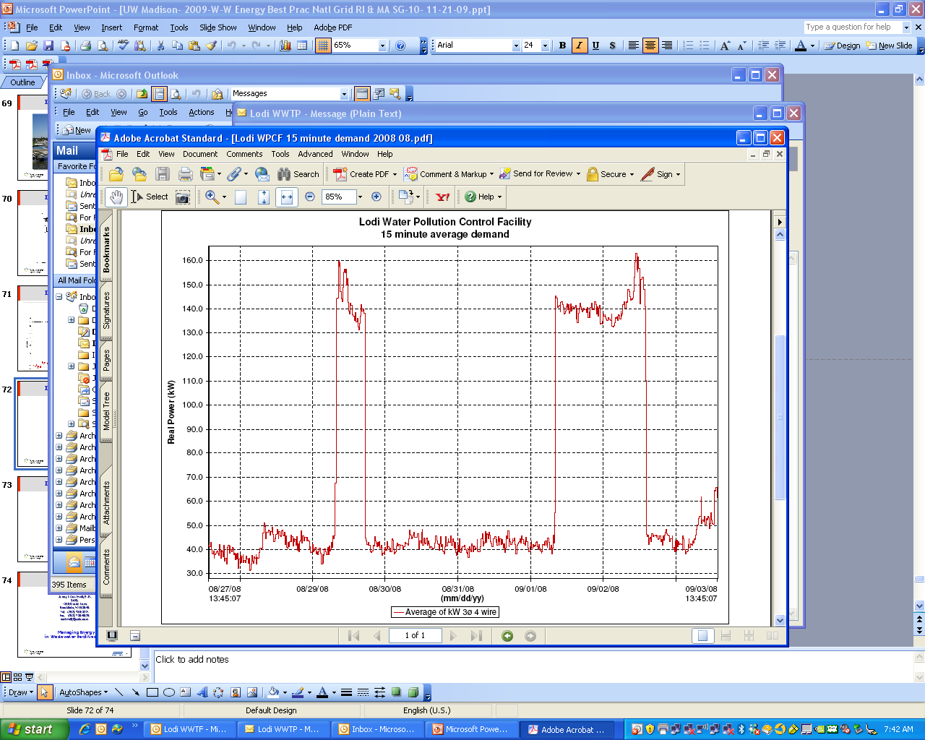
Understand Electric Demand
Are some operations on-peak when they could go off-peak (peaks are weekday sludge-mixing)?

Slide 19
Understand Electric Demand
Turn aerators on periodically (1990 - 2005)
100hp x 0.746kW/hp x $8.50/kW x 12 mo/yr
= $7,600/yr
$7,600/yr x 15 yr
= $114,000
This operator installed a timer/sequencer to perform this during off peak demand and started saving $7,600 per yr in 2006. This cost them $200 to implement.

Slide 20
Aeration Opportunities
EXAMPLE – AERATION CONTROL PARAMETER
Aeration tank volume: 50 ft x 250 ft x 18 ft = 225,000 ft
Floor area: 50 ft x 250 ft x 0.125 cfm/ft² = 1,563 cfm (Mixing)
Code (air rate capability)@ 20 cfm/1000 ft³ = 4,500 cfm (Mixing)
Organic loading: (3.5 MGD) BOD = 3,500 lb/day & NH₃ = 625 lb/day
(3,500 lb/day x 1.1lbO₂/BOD x ft³/0.0172 lbO₂/ft³air x day/1440 min)/0.20_{eff} = 777 cfm
(625 lb/day x 4.6 lbO₂/lbNH₃ x ft³/0.0172 lbO₂/ft³air x day/1440 min)/0.20_{eff} = 580 cfm
777 cfm + 580 cfm = 1,357 cfm

Slide 21
Aeration Mixing Designed to Code
Floor area: 50 ft x 250 ft x 0.125 cfm/ft² = 1,563 cfm (Mixing) = 75 HP
75 hp X (0.746 kWh/hp/0.90_{eff}) x 8,760 hr/yr x $0.10/kWh = $54,460/yr
4,500cfm @8.5 psi = 200hp x (0.746 kWh/hp/0.90_{eff}) x 8,760 hr/yr x $0.10/kWh = $145,200/yr
SAVINGS = $90,700 per year
Facilities are typically designed to code but each facility is different and can achieve adequate mixing with reduced aeration.

Slide 22
Aeration Designed for Maximum Loading
Measuring DO and varying air supply to match a DO of 2mg/l will provide significant savings (typical M-F).

Slide 23
DO Management
Actual | Setpoint | Savings
DO | DO | Fraction | %
2 | 2 | - | -
3 | 2 | 1/8 | 12.5
4 | 2 | 2/8 | 25
5 | 2 | 3/8 | 37.5
6 | 2 | 4/8 | 50
7 | 2 | 5/8 | 67.5
8 | 2 | 6/8 | 75
Many facilities set DO but have a much higher DO than necessary.

Slide 24
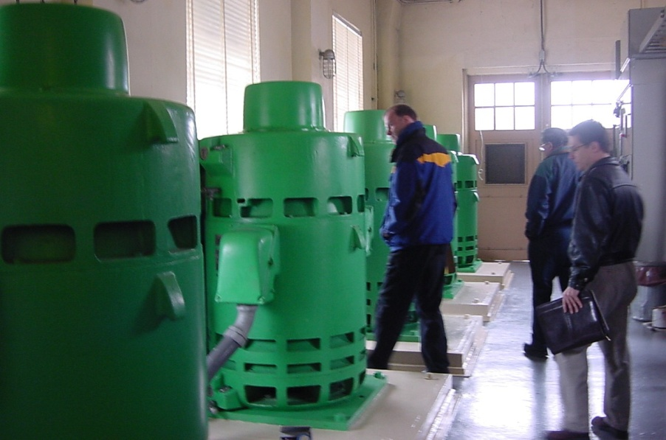
Pumps
EVALUATION: 1,690 pumps at 20 process plants (European study)
Average Pumping efficiency is below 40%
Over 10% of pumps run below 10% efficiency
Major factors affecting pump efficiency: Throttled valves; pump over-sizing
Seal leakage causes highest downtime and cost.
Notes:
24

Slide 25
Pumps
 | Range of Eff. | Low | Ave | High
Motor | 85-95 | .85 | .9 | .95
Drive | 20-98 | .20 | .6 | .98
Pump | 30-85 | .30 | .6 | .85
Eff. of System |  | .05 | .32 | .80
5 percent to 80 percent

Slide 26
Pump Data to Gather
  Pump performance curve
  Drive (if applicable)
  Motor specifications
  Design information
  Amp draw (field-measured)
  Existing flow conditions
  System components
    Static
    Dynamic – conveyance configuration
  DOE PSAT is a simple and great tool to find if your pump is optimized. http://www1.eere.energy.gov/industry/bestpractices/software.html

Slide 27
Pumps
Savings at an Actual Facility through VFDs
Well | Throttled |  | Amp Draw |  | Savings
 | From (GPM) | To (GPM) | From (throttled) | To (vfd) | %
5 | 900 | 700 | 150 | 99 | 33
7 | 1,200 | 870 | 170 | 98 | 42
8 | 1,600 | 1,100 | 170 | 125 | 26
Not all throttled pumps are candidates for Variable Speed Drives, but should be considered.
© 2009 Science Applications International Corporation. All rights reserved. SAIC and the SAIC logo are registered trademarks of Science Applications International Corporation in the U.S. and/or other countries.

Slide 28
Energy Savings Obtained Through Installed Projects
Facility A (oxidation ditch - installation of VFDs)

Slide 29
Energy Savings Obtained Through Installed Projects
Facility B (Package AS Plant – installed fine bubble aereation, smaller blower, and DO control)

Slide 30
Energy Savings Obtained Through Installed Projects
Facility C (same as Facility B)

Slide 31
Stories
Main industry (dairy) moved out of town seven years ago, but nothing adjusted at treament plant – could have just turned aeration blower off
75hp x 0.746 kW/hp x 8,760 hr/yr
x 7yr x $0.05/kWh
= $171,500

Slide 32
Stories
Final effluent pump operates continuously (1980)
15hp x 0.746kW/hp x 8,760 hr/yr
x 25 yr x $0.04/kWh
= $98,000

Slide 33
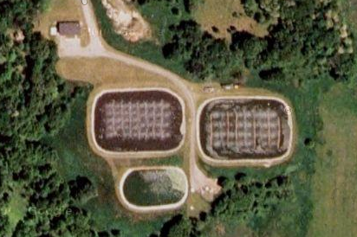
Aerated Lagoons

Slide 34
Stories
An aerated lagoon wastewater treatment facility consisting of three lagoons (two aerated and one settling).
The two aerated lagoons had been using helixor aerators with three 40 hp blowers.
The annual electric consumption was 494,710 kWh/yr, relating to 7,340 kWh/million gallons.
The village installed a new fine-bubble diffusion system and reduced the speed of the existing blowers.
Resulting in energy savings of 264,000 kWh/yr

Slide 35
Installed Projects
80,000
70,000
60,000
Coarse Bubble Diffusers
Avg. Monthly Power Consumption = 45,660 kWh
50,000
kWh per month
40,000
Fine Bubble Diffusers
Avg. Monthly Power Consumption = 21,047 kWh
30,000
20,000
10,000
0
Oct-05
Nov-05
Dec-05
Jan-06
Feb-06
Mar-06
Apr-06
May-06
Jun-06
Jul-06
Aug-06
Sep-06
Oct-06
Nov-06
Dec-06
Jan-07
Feb-07
Mar-07
Apr-07
May-07
Jun-07
Jul-07
Aug-07
Sep-07
Oct-07
Nov-07
Dec-07

Slide 36
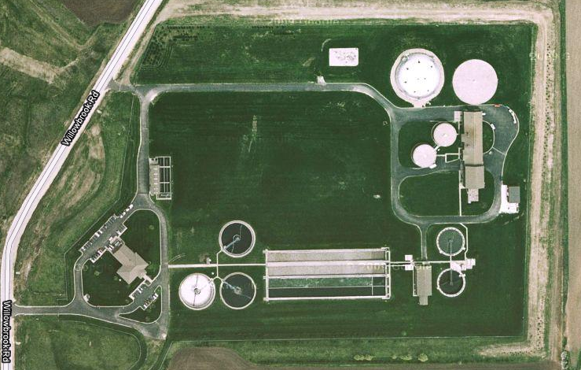
Installed Projects…

Slide 37

Municipal Wastewater Treatment Facility
An activated sludge facility
The WWTF was not loaded at design however all aeration tanks were being aerated
The City installed a new flexible membrane fine-bubble diffusion system in two tanks to allow them to idle the tanks the majority of time
The City has recently installed new variable speed drives on their blowers to better control air flow
The annual electric consumption reduction was forecasted to be 75,000 to 100,000 kWh/yr

Slide 38
New Facility Planning
Energy efficiency needs to become an integral component of all facility planning efforts.
Design development needs to incorporate flexibility so as not to be energy efficient only on the 365th day of the 19th year of operation.
Does all equipment need to be in operation?
Flexibility in equipment selection
Range of operation
Energy efficient throughout range

Slide 39
Conclusion
Energy use awareness is first step toward management
You can save energy without impacting treatment quality
Savings of 20 percent to 50 percent are generally available (70 percent has been attained)
Savings are available at all facilities
Copyright 2009
Notes:
39

Slide 40
IF YOU HAVE QUESTIONS, PLEASE CONTACT:
Joseph Cantwell, P.E.
SAIC
1845 Derrin Lane
Brookfield, WI 53045
Tel: (262) 786-8221
Fax: (262) 786-5925
cantwellj@saic.com

Slide 41
Act On Energy® Business: What is Act On Energy?
Offers financial incentives to customers to be more energy efficient
Rate Relief Act (passed in 2007) by Illinois Legislature
  Created energy efficiency program to be administered by Utilities
  Municipalities and co-ops declined to participate
Funded by you the customer
  EDR Rider on your bill
  Must be a delivery customer of Ameren Illinois
  Public facilities go thru DCEO

Slide 42
Act On Energy® Programs
ELECTRIC
Lighting
Refrigeration
VFD for motors
Grocery/Convenience Store
Custom
Retro Commissioning
  Compressed Air
  Healthcare
Electric & Gas*
HVAC
Commercial Kitchens (New)
Agriculture (New)
Lodging (New)
SMALL BUSINESS - ELECTRIC
On-Line Store
*Gas programs available to GDS-2 customers only. Open to all GDS rate classes on June 1, 2011.
Notes:
42
NOTE: Included in the packet of information is a sheet listing and describing all the Business Programs ……………

Slide 43
Act On Energy® Business: PY3 Electric Goals
PY1 Goals
Totals
Energy Savings
46,000,000 kWh
12,500 therms
$3,000,000
PY2 Goals
Totals
Energy Savings
84,000,000 kWh
551,000 therms
$7,000,000
PY3 Goals
Totals
Energy Savings
115,000,000 kWh
1,000,000 therms
$11,000,000

Slide 44
Act On Energy® Business: What’s Been Accomplished
In the first two years of the business program:
Reduced 108,911 metric tons of carbon emission – equivalent to emission from 21,695 cars
Achieved at least 138,000,000 kWh in energy savings – enough energy to power 12,602 homes for a year
Saved business customers $17M annually in electric energy costs

Slide 45

Program Opportunities

Slide 46
Act On Energy® Business
Each facility is unique and energy use varies
The EPA estimates about 30% of energy usage in facilities is inefficient or unnecessary
Inefficient or unnecessary energy usage is an even greater concern in facilities having longer operating hours (24 x7). These facilities also have a greater potential for energy savings

Slide 47
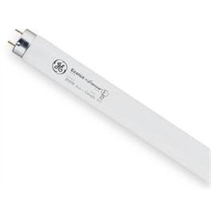
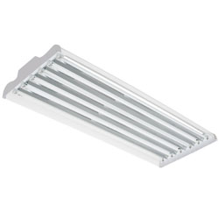
Best Practices: Lighting
Numerous opportunities in your facility
  High-performance or low-wattage lamps in warehouse, aisles, canopy
    T8
    T5
Switching from 4 lamp T12 with magnetic ballast to high-performance/low-wattage lamps will save about 33% in energy cost
Base incentive ranges from $3 to $5 per lamp per fixture

Slide 48
Best Practices: Lighting T12 Phase-Out
2007 Energy Independence & Securitization Act
  Increased the standards for T12 lighting
  Most current T12 lamps will no longer be manufactured after July 2012
  T8 lamps will become the new standard for linear fluorescent
Act On Energy cannot incentivize “standard practice”
  T12 is standard practice now
  T8 will be standard practice in 2012
Help educate the public on upcoming changes in the marketplace

Slide 49
Best Practices: Lighting T12 Phase-Out
Act On Energy is currently offering a 10% bonus on top of current T12 retrofit incentive amounts
  Now is the best incentive Act On Energy will ever offer for these measures
  The 10% bonus will be offered for a limited time and then the bonus will drop to 5%
The bonus amount will continue to decrease and ultimately the incentive will decrease also
Customers & allies can be sure when they submit an application for T12 retrofit they will receive the best possible incentive for their project

Slide 50
Best Practices: Lighting
High bay fixture replacement
Metal halide lights typically use 450 or 1,100 watts
  Quality of light decreases over time
Can replace with a 6 lamp T5 fixture - reduces energy consumption to around 300 watts
Maintains quality of light
Newer lamps have longer rated life and better light output
$0.25 per watt reduced base incentive plus current BPL91 bonus
Notes:
50

Slide 51
Sample Lighting Project – High bay replacement
Project cost: $141,120
Amount of annual energy savings: $86,298
Act On Energy incentive amount: $54,978
% of project covered by incentive: 39%
Project payback: 1.64 years
Completed additional six locations following initial project
Does not include current BPL91 bonus
Notes:
51
Completed a total of 7 projects
Received applications for 4 additional projects in PY2
Saved a total of $500,000 dollars in energy costs annually for completed PY1 projects

Slide 52
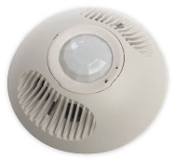
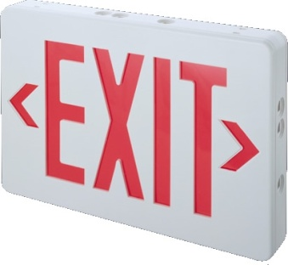
Best Practices: Lighting
Occupancy sensors for your warehouse or isles
  Turns off lights when room is unoccupied
  Turns lights on when an employee walks
  into area
  Incentive of $15 per control
LED exit signs
  Older exit signs typically use $65 per year
  per sign
  LED exit signs use $3 per year per sign
  Typically cost $35 to purchase
  Incentive of $20 per exit sign

Slide 53
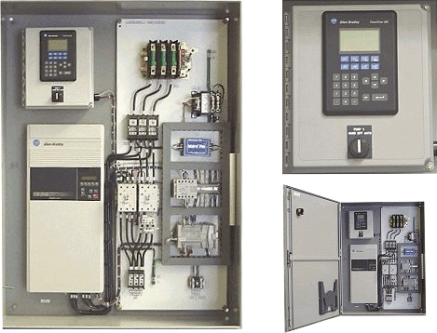
Best Practices: VFDs
Motors are typically on or off
Turning motors on and off frequently to meet capacity creates significant wear & tear
VFDs adjust the power supply to the motor to
  meet demand
Savings vary by size of motor and peak times, but VFDs typically provide significant energy savings
$75 per hp controlled incentive from Act On Energy
Percent of project that Act On Energy will pay with special VFD incentive increased to 75%

Slide 54
Sample - Pump Motor/VFD Project
200 HP VFD
Project cost: $28,812
Amount of annual energy savings: $105,853
Act On Energy incentive amount: $15,000
% of project cost covered by incentive: 52%
Project payback: 0.24 years
Notes:
Completed a total of 7 projects
Received applications for 4 additional projects in PY2
Saved a total of $500,000 dollars in energy costs annually for completed PY1 projects

Slide 55
Best Practices: Compressed Air
Production of compressed air typically accounts for 10-30% of total energy consumed in plants
Average industrial cost for compressed air production: 15-30 cents per 1,000 cubic feet of compressed air
Efficiency of some compressed air systems can be as low as 10-15%
System leaks can waste as much as 20 to 30% of the compressed air output
Leaks also cause:
  Fluctuating system pressure, which can cause air tools and other air-operated equipment to function less efficiently, possibly affecting production
  Excess compressor capacity, resulting in higher than necessary costs
  Decreased service life and increased maintenance of supply equipment (including the compressor package) due to unnecessary cycling and increased run time
www.oit.doe.gov

Slide 56
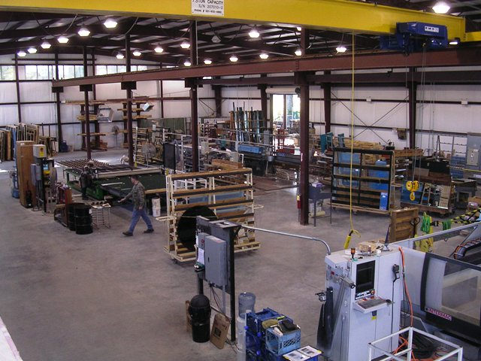
Best Practices: Compressed Air
Retro Commissioning
  Leak loss reduction
  Adjustment of an existing flow controller
  or sequencer to match plant operations
  Correction of inappropriate uses of
  compressed air such as open blowing
Pays for 50% to 80% of the survey cost
Low cost, no cost fixes
Must be a facility over 100,000 sq ft

Slide 57
Sample Compressor System Upgrade Project
Project cost: $200,000
kWh Savings: 1,794,924
Amount of annual energy savings: $98,721
Act On Energy incentive amount: $100,000 (maxed)
% of project covered by incentive: 50%
Project payback: 1.11 years
Notes:
Completed a total of 7 projects
Received applications for 4 additional projects in PY2
Saved a total of $500,000 dollars in energy costs annually for completed PY1 projects

Slide 58
Best Practices: Custom
Custom Incentives
Energy Savings Incentive | Lighting $0.05/kWh All other measures $0.07/kWh
Minimum Payback | 1.0 years
Maximum Payback | 7 years
Cap of $600,000 per facility per year (Standard & Custom)
Incentives paid at 50% after facility receives $200,000 in PY3
Incremental cost must fall in the range of 10% to 50%
Pre-approval required
Incentives >$25K require Large Incentive Request Form
Standard Lighting, HVAC, Motors and Refrigeration measures must apply through their respective programs

Slide 59
Current Bonus Offerings

Slide 61
Sweet Deal 15% Bonus
Went into effect on February 14th
T12 measures not applicable/cannot combine with other bonuses
Application must be submitted by March 31st
Project must be completed by May 31st
Final paperwork must be submitted by June 30th

Slide 62
Large Industrial/Commercial VFD – Sweetest Deal of All!!
Original VFD incentive was $40 per controlled HP
Temporary bonus added in PY2 increased VFD incentive to $75 per controlled HP
Eventually adopted $75 per controlled HP as normal VFD incentive
Sweet Deal limited-time bonus increases VFD incentive to $86.25 per controlled HP!!
The percent of the project cost Act On Energy will cover has also increased to 75%. These increases allow for a quicker customer payback on their project.
Act On Energy recently incentivized a project for 7 VFDs on large equipment at a manufacturing facility. Because of this project, that company received over $50,000 in incentives with a payback of just under 1.4 years and will save almost $81,000 dollars in annual energy costs.

Slide 63
Getting Started

Slide 64
Getting Started
Identify opportunities in your facility
  Lighting/Energy audit or compressed air audit
  Contact a Registered Program Ally or contractor for assistance
Complete & submit an AOE application
  We will notify you when project is pre-approved
  DON’T make financial commitments before pre-approval
  Note: Standard projects <$5K incentive do not require pre-approval
When Project is complete submit
  Final application
  Pre-approval letter
  Invoices of purchased equipment
Receive check in 6 to 8 weeks after approved for final payment

Slide 65
Resources and Support

Slide 66
AOE Program Resources
Act on Energy website:
  http://www.actonenergy.com
Program Manager
    Lance Escue (Peoria): 309-677-5575
    lescue@ameren.com
Ameren Illinois Key Account Executives
Technical Review Team
Act On Energy Call Center (Margie Yankowski) 866-800-0747
Notes:
Completed a total of 7 projects
Received applications for 4 additional projects in PY2
Saved a total of $500,000 dollars in energy costs annually for completed PY1 projects

Slide 67
Questions???

